Slide 1

Stress: What, who, why and how.
September 13th, 2015

Slide 2
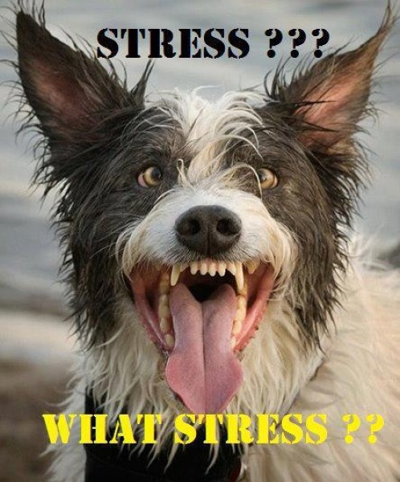
What?
What is stress?
  a state of mental or emotional strain or tension resulting from adverse or very demanding circumstances.
What stresses you out?
  School, parents, friends, expectations, society, etc.
  Anything else?
Is all stress bad?

Slide 3
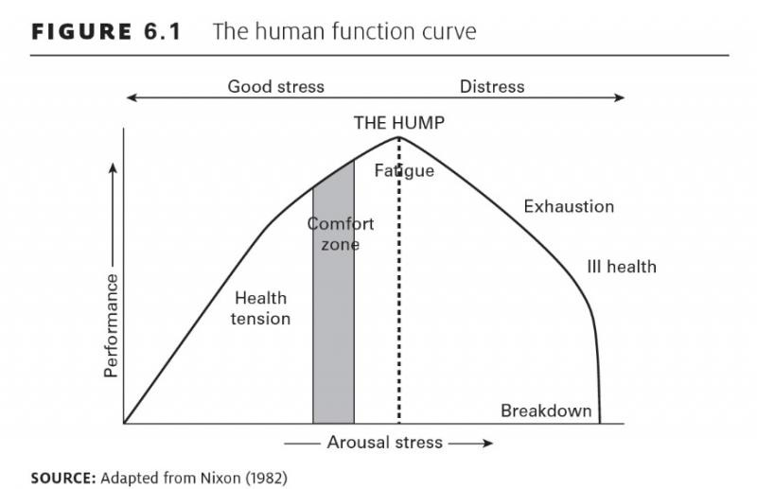
Notes:
What do you notice about this graph?
What do you see?

Slide 4
What?
Split into two groups.
Choose two volunteers from each group to be the test subjects.
Activity: Stress obstacle course!
  Physical stressors: Suicides in large open area. Set boundary before hand. 10 push ups. 10 jumping jacks.
  Mental stressors: Complete math problems on the white board.
        Problems: 4x4, 38/6, 2x+17= 0
        Board Game: Operation remove two pieces. If you hit buzzer you have to start over completely.
  Societal Stressors: “You’re Outfit Of the Day didn't get enough likes on instagram” change it to get more likes
Notes:
Instructions: Have each group choose two volunteers to be the groups test subjects.
Group 1: Negative Stressors-
Group members will function as negative stressors on their test subjects. Negative comments, unhelpful suggestions, general distractions, etc.
Group 2: Positive Stressors-
Group members will function as positive stressors in what ever way they think is appropriate, encouragement, compliments, helpful hands.

Slide 5

What?
Debrief:
  In small groups discuss:
  What did it feel like to be a test subject.
  What did it feel like to be a stressor.
  What did you notice while observing.

Slide 6
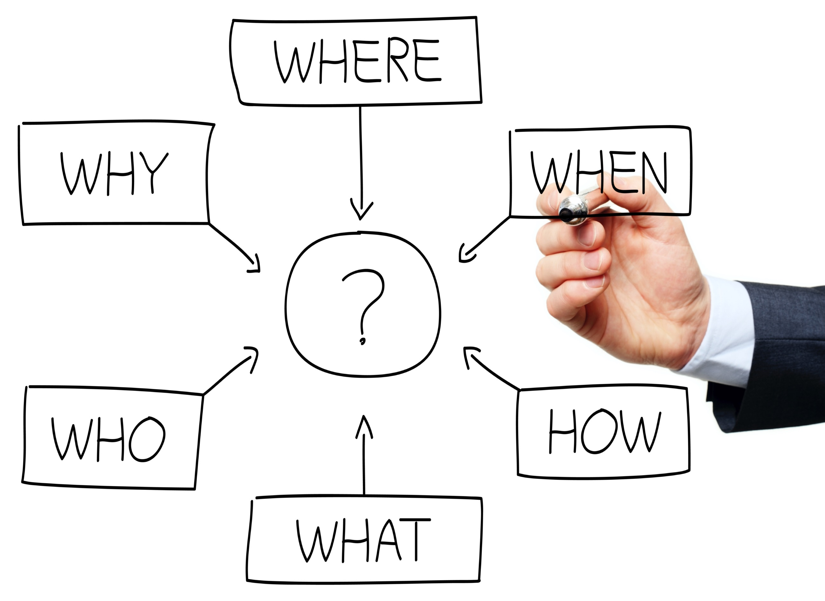

Slide 7
Next Week: Why, and How
Why does our body become stressed? Is there a reason?
How do we manage/overcome stress?
Notes:
Don’t forget highlights and bummers.

